Slide 1

ANALYSIS OF MENTAL HEALTH CARE IN USA
NAME : ROHITH SINGH THAKUR
STUDENT ID : 11753512
INFO 5709: DATA VISUALIZATION

Slide 2
INTRODUCTION
Mental health is important for overall well-being, but it can be complex and challenging.
Cognitive impairment affects thinking, memory, and decision-making, making daily tasks difficult.
Aging often brings a decline in cognitive abilities, leading to frustration and loss of confidence.
With proper support, people can overcome emotional difficulties and adapt to changes in mental health.

Slide 3
DATA SET
Dataset containing a detailed study of the variation in mental health across the USA from 2020 to 2022 while also diagnosing the impact of the COVID-19 period on the general mental health.
The dataset is collected from data.gov which is a .cvs file extension.
This dataset contains 10,404 rows.
The attributes are age, education, cognitive impairment level, confidence level, and gender etc.
Data set link: https://catalog.data.gov/dataset/mental-health-care-in-the-last-4-weeks

Slide 4
DATA CLEANING
Tools used for Exploratory Data Analysis (EDA)
1) Python
2) Jupyter Notebook
EDA helps us to find the structure of dataset, identify patterns and gain insights for future analysis.
After performing the EDA, the data remained same as there are no Null values.

Slide 5
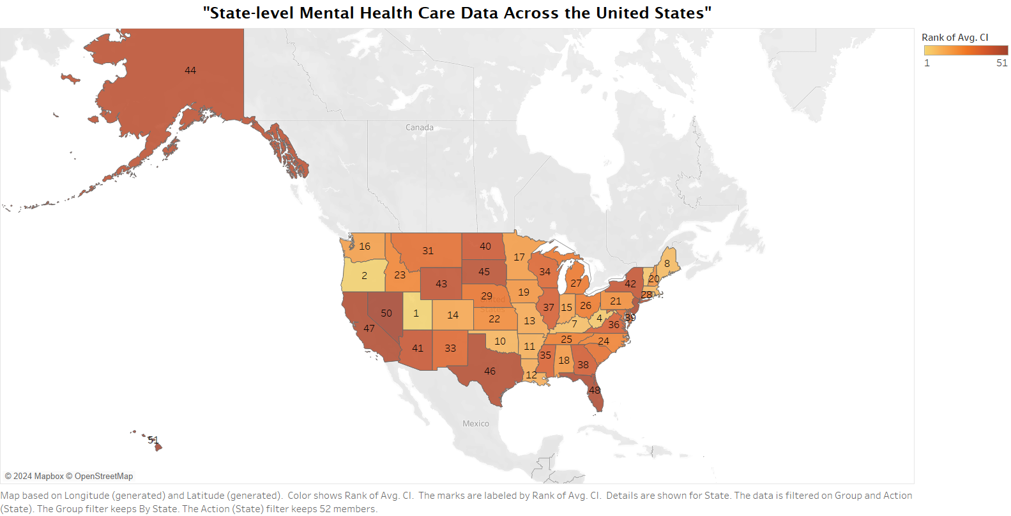
HYPOTHESIS AND VISUALIZATIONS
Does the degree of cognitive impairment in mental health and average mental health care value correlate with one another? Which state ranks 1st in CI level?
a) Map
Utah ranks 1, as it has the highest average number of values of cognitive impairment level represented the gold color
Several states in the central and eastern regions, such as Texas, Florida, and New York, have relatively lower ranks of cognitive impairment levels, shown in darker shades of orange.

Slide 6
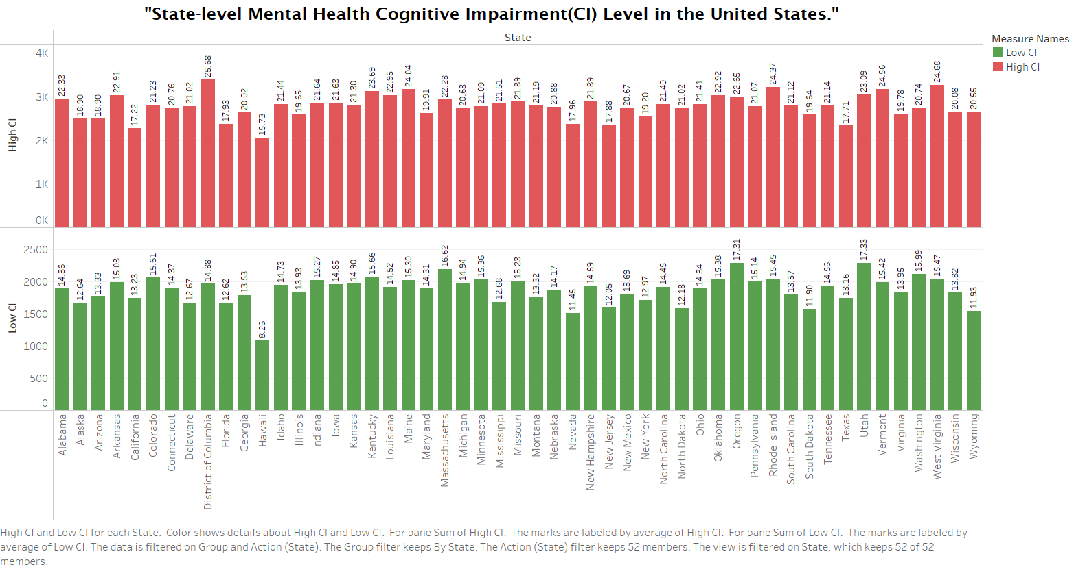
b) Bar Graph
The highest SUM(High CI) value is observed for District of Columbia (around 3,390) and Avg CI value is 25.68
The highest SUM(Low CI) value is observed for Utah (around 2,287)and Avg CI value is 17.33, followed by Oregon (around 2,284).

Slide 7
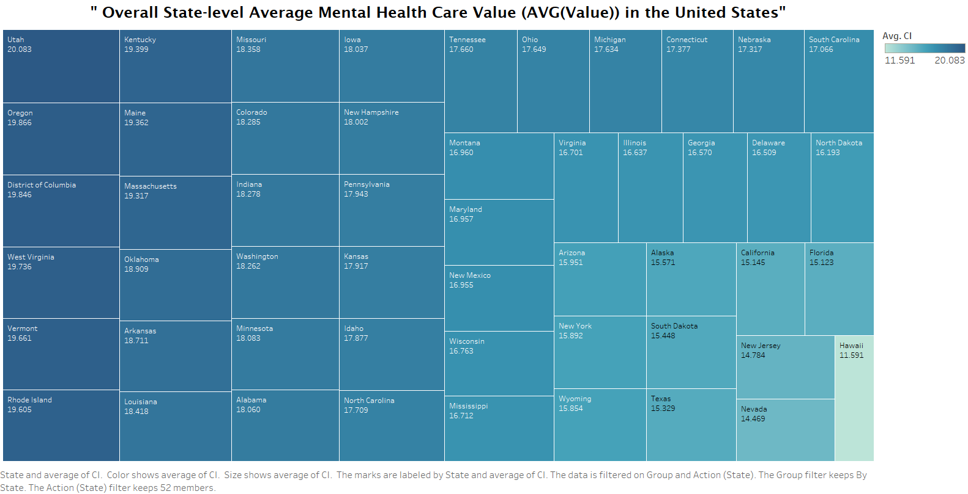
c) Tree Map
For instance, Utah stands out with one of the darkest shades indicating one of the highest average values of approximately 20.083, while Hawaii is at the opposite end with one of the lightest shades and the lowest average value of approximately 11.591.
This suggests significant disparities in mental health care value across the states

Slide 8
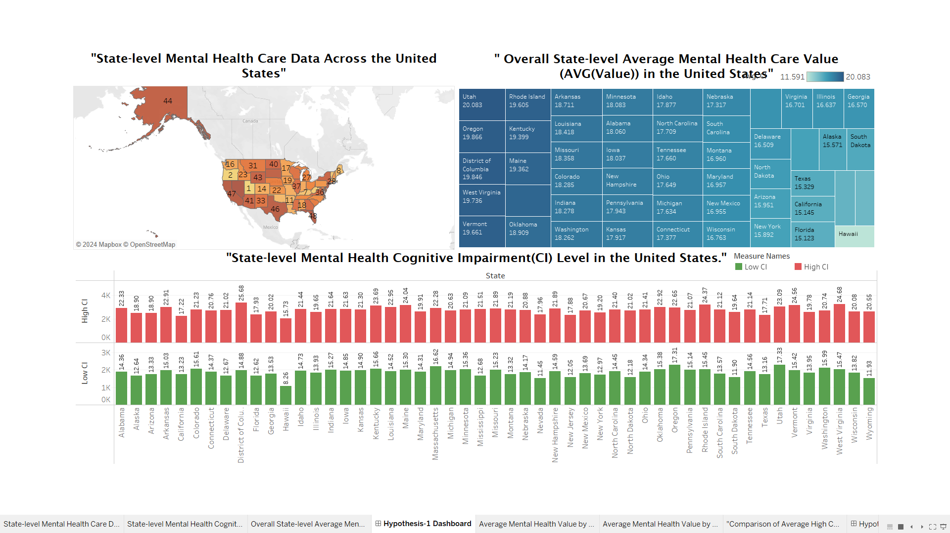
Dashboard
A: Indeed, there is often a relationship between degree of cognitive impairment in mental health and average mental health care value correlate with one another.

Slide 9
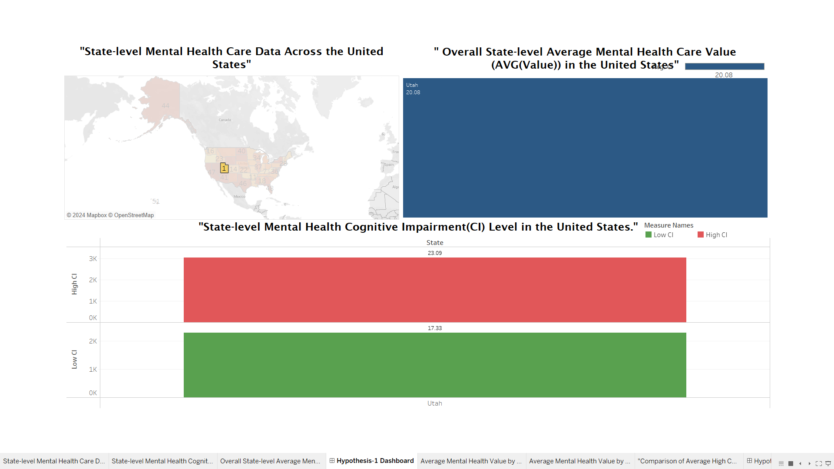
INTERACTIVE DASHBOARD

Slide 10
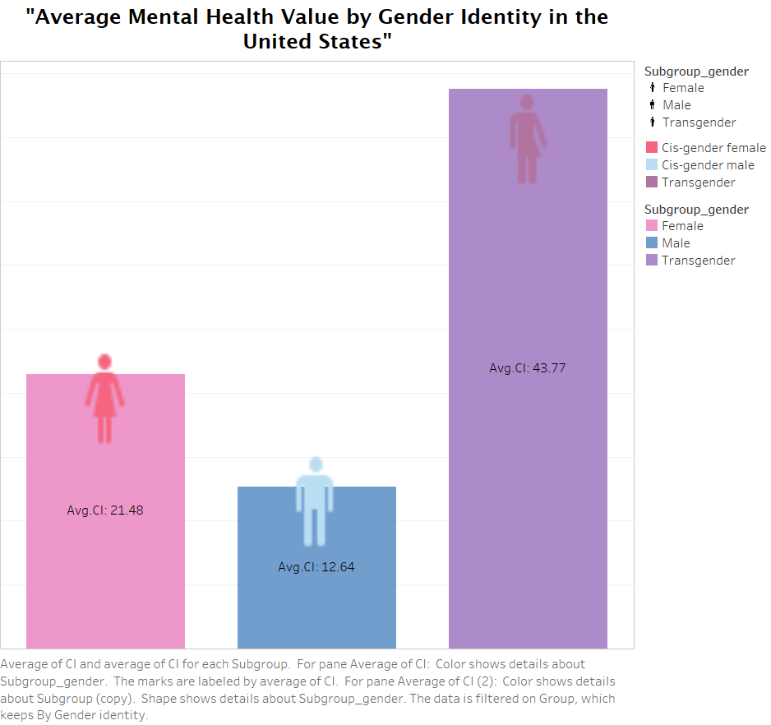
2) Is there a statistically significant difference in average mental health values among different gender identities and education levels in the United States, as well as in the high confidence intervals for mental health care data?
Bar Graph
The bar chart shows that the average mental health value is highest for the Transgender identity group, with an Avg CI of 43.77, followed by the Female group at 21.48, and the Male group at 12.64.

Slide 11
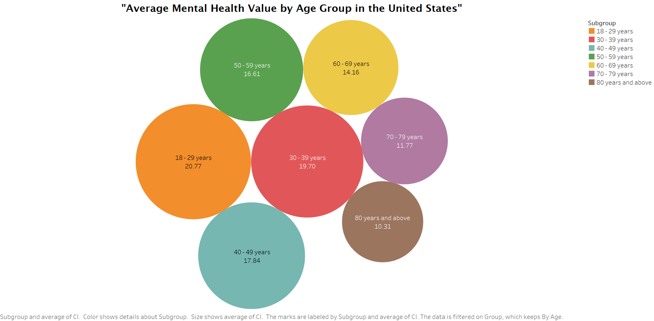
b) Packed Bubble chart
The graph shows a trend whereby the average mental health score declines as age increases. Age groups that are younger, such as "18-29 years," have the greatest average mental health values.
As one gets older, the values gradually decline, with the "80 years and above" group having the lowest values.

Slide 12
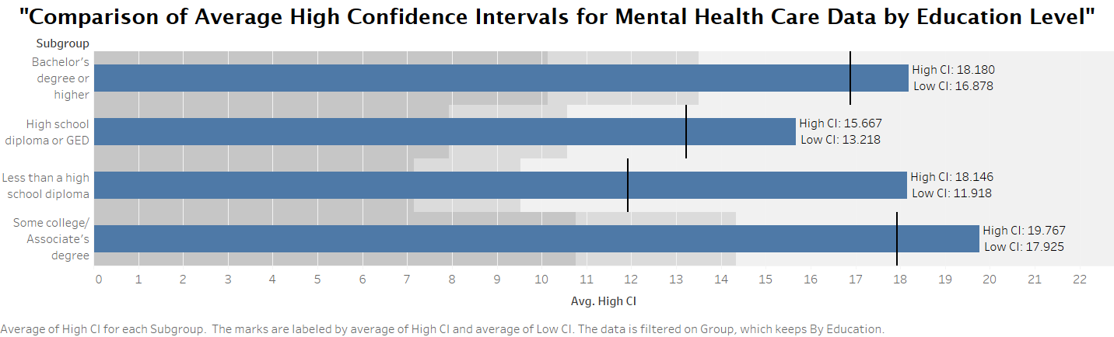
c) Bullet Bar Graph
According to the bar chart, those who identify as having a "Bachelor's degree or higher" have the highest average high CI value and a wider confidence interval range.
The group with "Less than a high school diploma" had the narrowest confidence interval and the lowest average high CI value.
Higher levels of education perhaps being linked to higher levels of self-reported mental health care needs over the COVID-19 time period from 2020 to 2022.

Slide 13
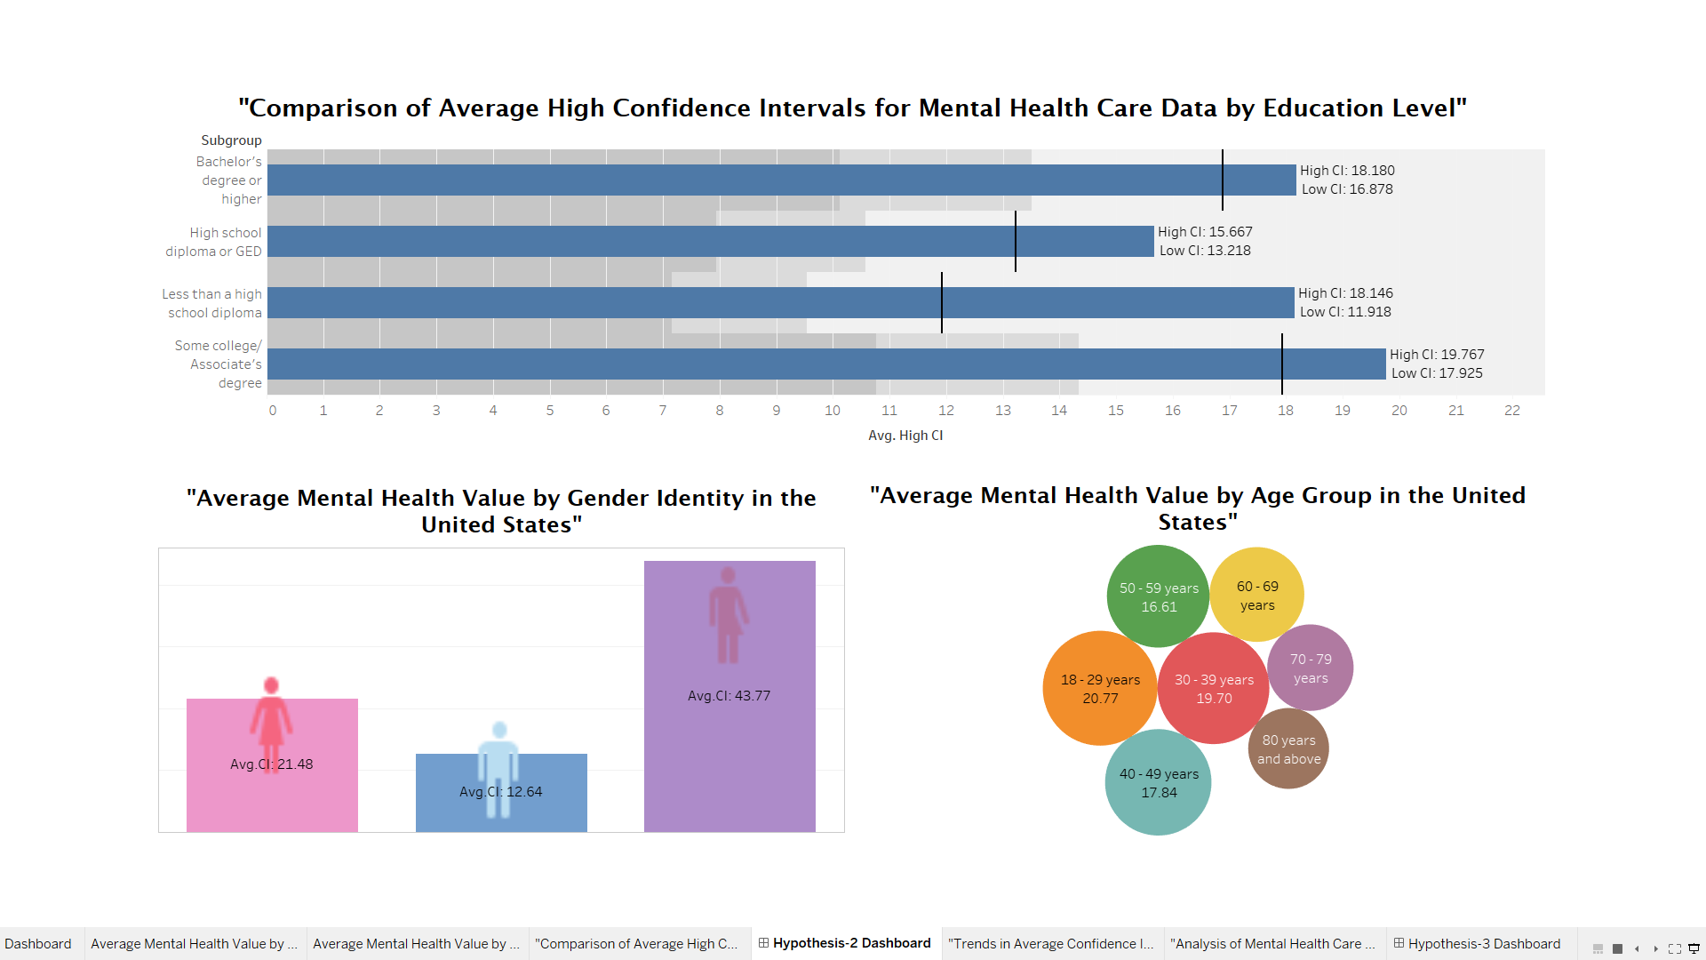
Dashboard
Yes, there is a statistically significant difference. The above is a dashboard that analyzes difference in average mental health values among different gender identities and education levels in the United States, as well as in the high confidence intervals for mental health care data.

Slide 14
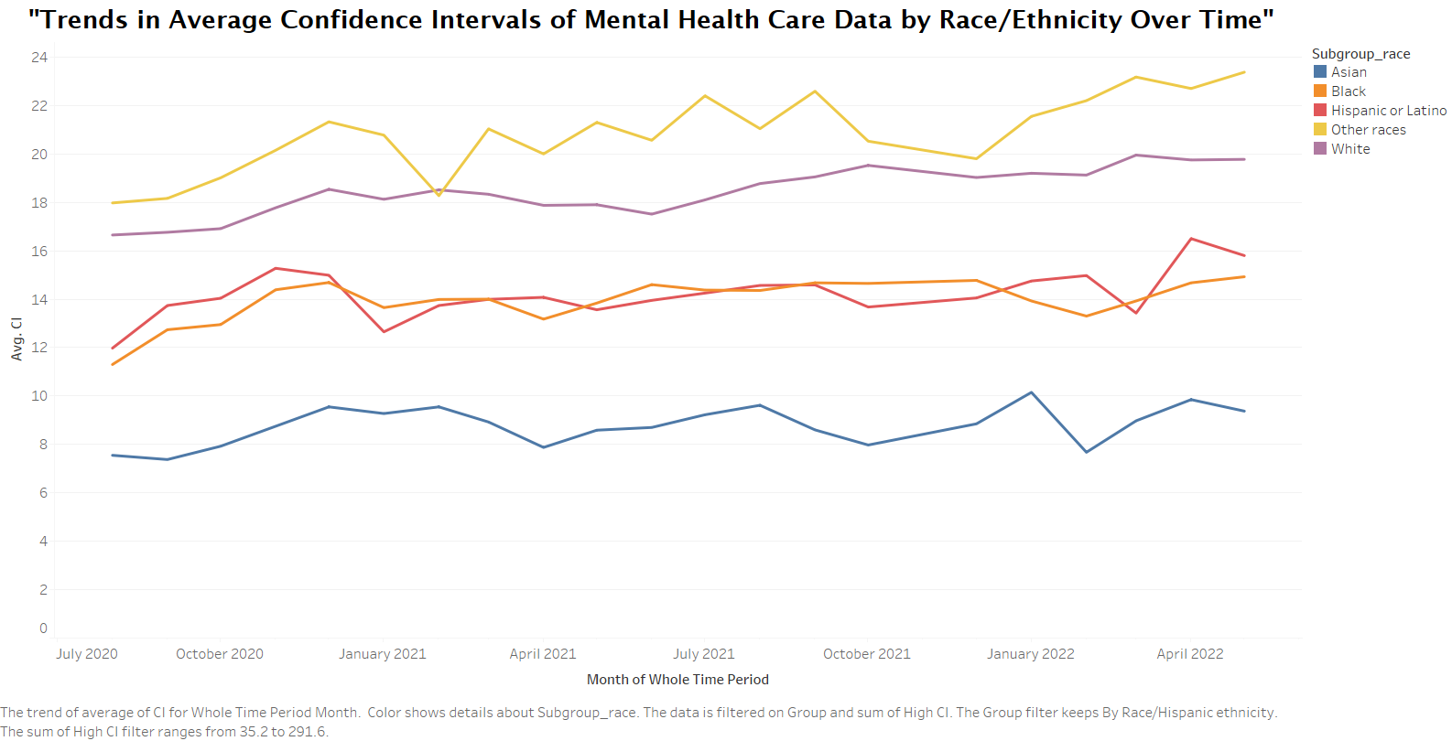
3) Does the average confidence interval for mental health care data vary significantly among different racial subgroups over time?
Line Graph
The Asian subgroup has the most stable and precise data on mental health care, with consistently low average cognitive impairment values.
The Black subgroup experiences a notable increase in average cognitive impairment in January 2021, followed by a gradual decrease until April 2022.

Slide 15
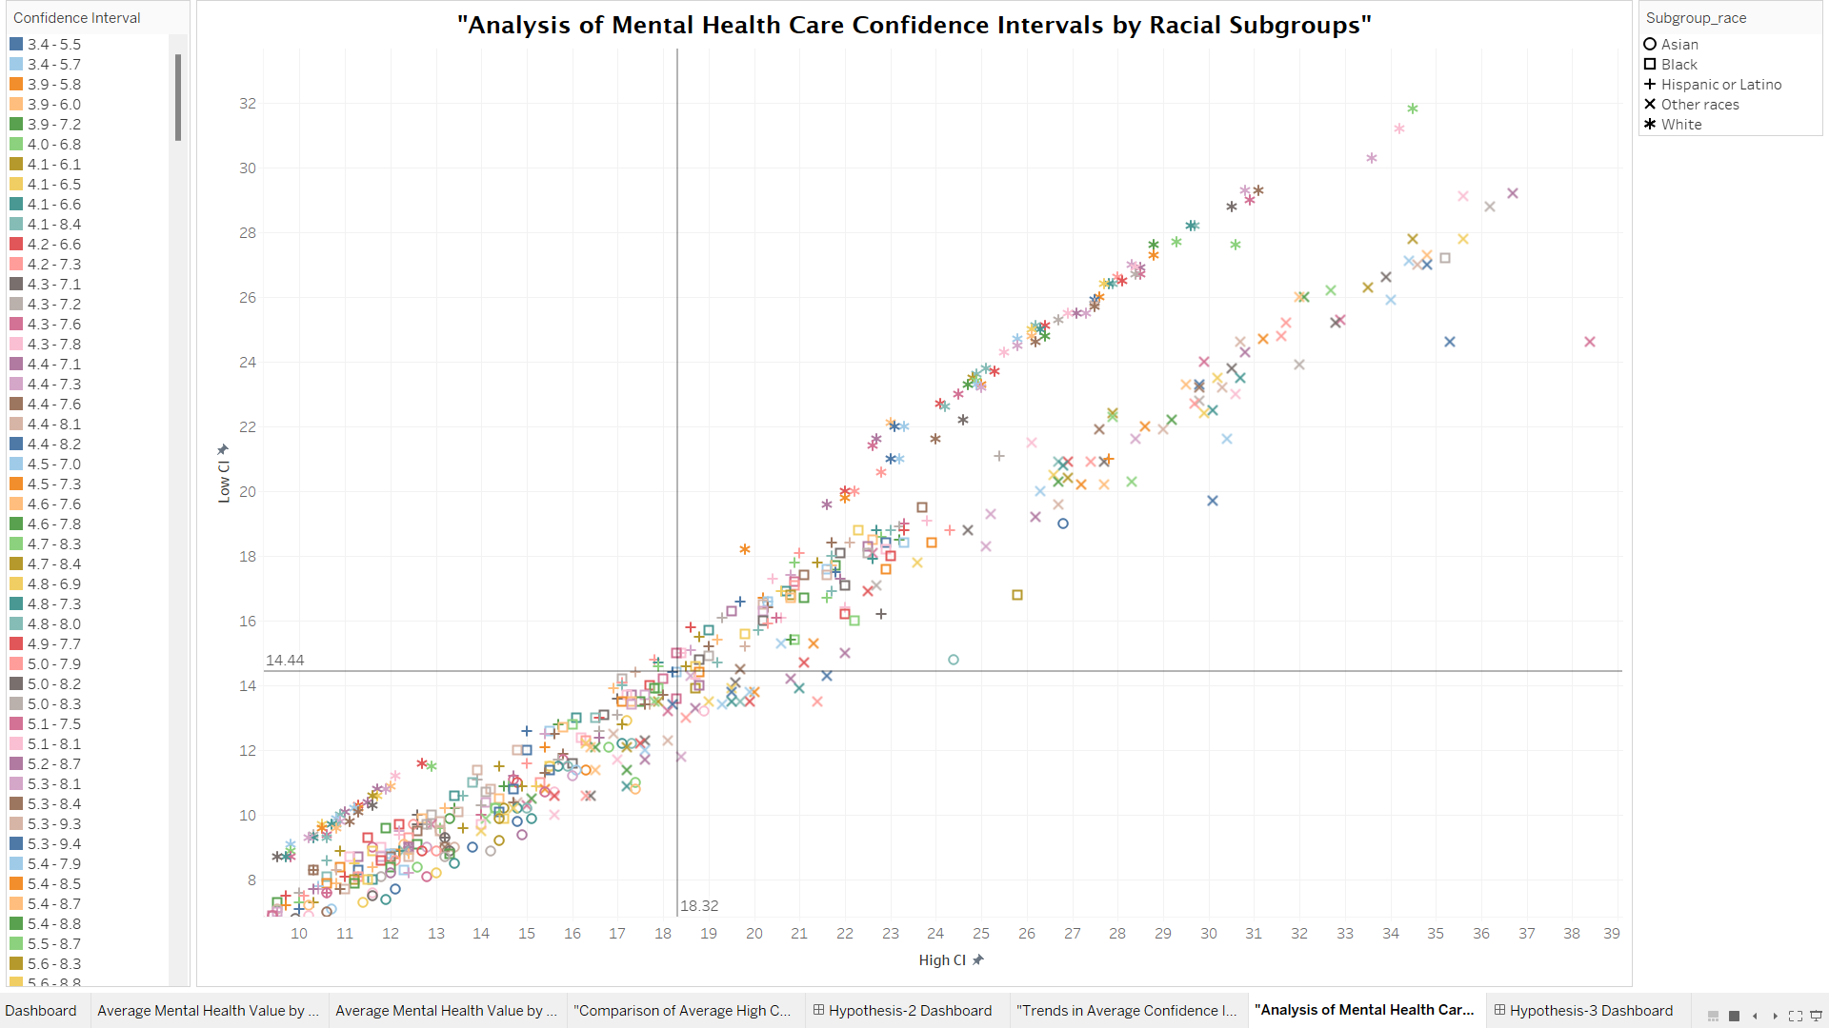
b) Scatter Plot
The scatter plot indicates a positive relationship between low and high cognitive impairment values, shown by data points aligning along a diagonal line.
The confidence intervals for mental health data across racial groups show similar distributions, suggesting no significant differences in uncertainty among the represented groups.

Slide 16
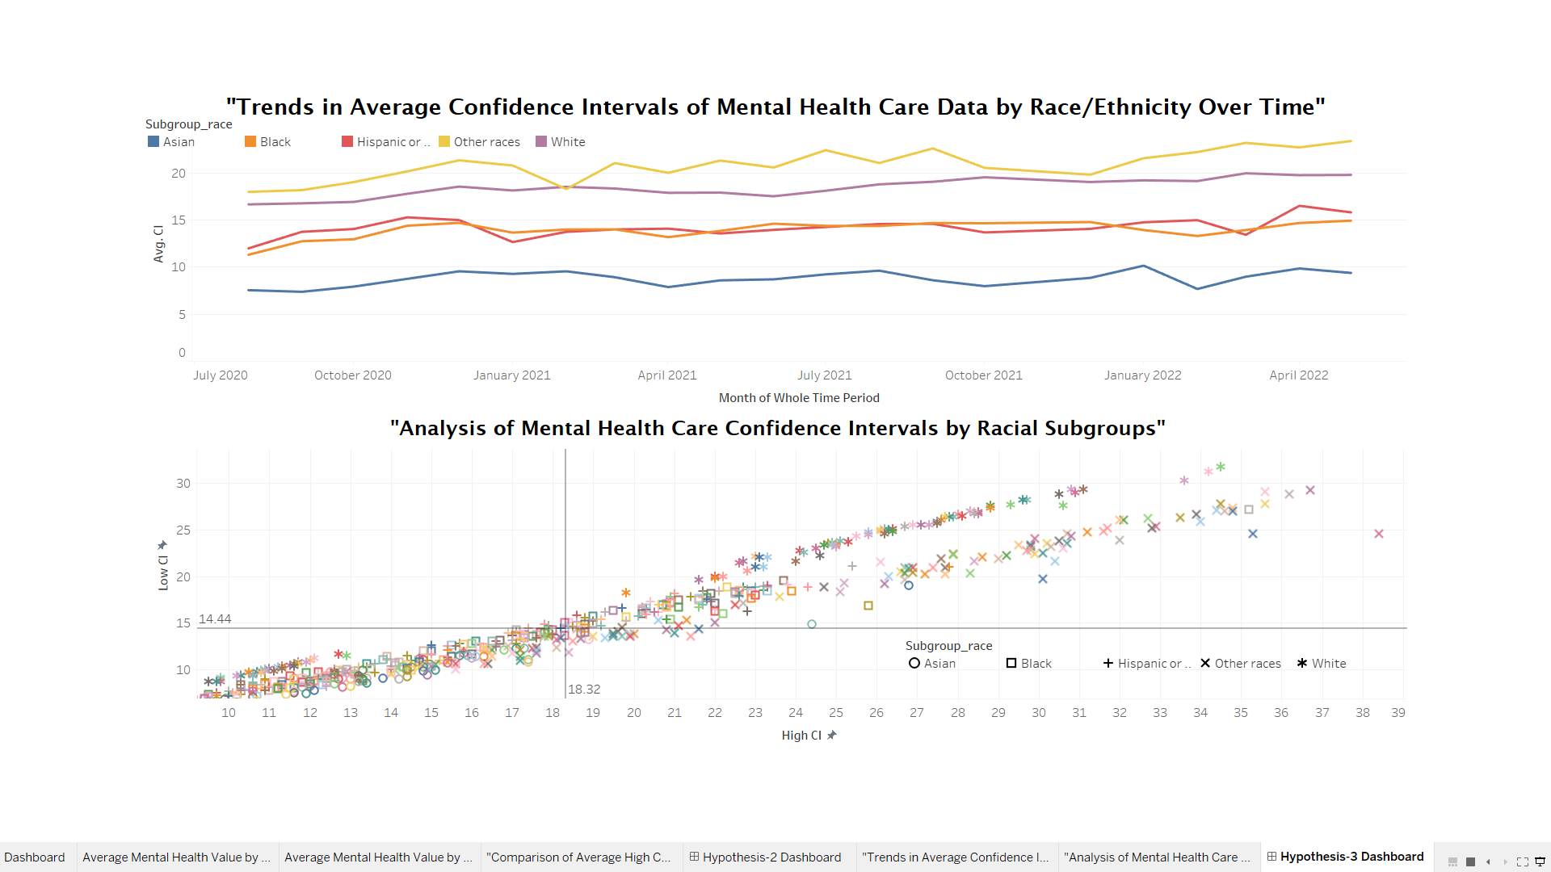
Dashboard
By analysis of the dataset the answer of third hypothesis, yes, the average confidence interval for mental health care data vary significantly among different racial subgroups over time.

Slide 17
CONCLUSION
The study shows that during the COVID-19 pandemic, there were notable differences in the mental health care data in the US among various age groups, racial subgroups, gender identities, and educational attainment levels
.
These results emphasize the necessity for equal access to care and support services, as well as the significance of specialized therapies and assets to address a range of mental health issues.

Slide 18
REFERENCES
[1]. Reinert, M. (2019-2020). SAMHSA, Center for Behavioral Health Statistics and Quality, National Survey on Drug Use and Health. Retrieved from https://www.samhsa.gov/data/nsduh/state-reports-NSDUH-2020
[2]. Guo, Z., Zhang, Y., & Liu, Q. (2022). Bibliometric and visualization analysis of research trend in mental health problems of children and adolescents during the COVID-19 pandemic. Frontiers in Public Health, 10, 1040676. Published online January 6,2023.doi: 10.3389/fpubh.2022.1040676 https://www.ncbi.nlm.nih.gov/pmc/articles/PMC9853402/
[3]. National Alliance on Mental Illness (NAMI), US Mental Health Statistics by 2024, https://worldpopulationreview.com/state-rankings/mental-health-statistics-by-state

Slide 19
THANK YOU

